Slide 1


Content
Data Analysis

Slide 2


Project agenda
Project recap
Problem
The Analytics team
Process
Insights
Summary

Slide 3

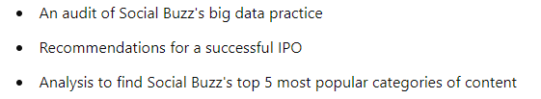
Social Buzz is a fast-growing technology unicorn that needs to adapt quickly to its global scale. Accenture has begun a 3-month POC focusing on these tasks:
Project Recap

Slide 4

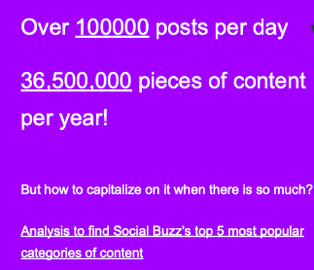
Problem

Slide 5
Process
1
Data Understanding
2
Data Cleaning
3
Data Modelling
4
Data Analysis
5
Uncover Analysis

Slide 6
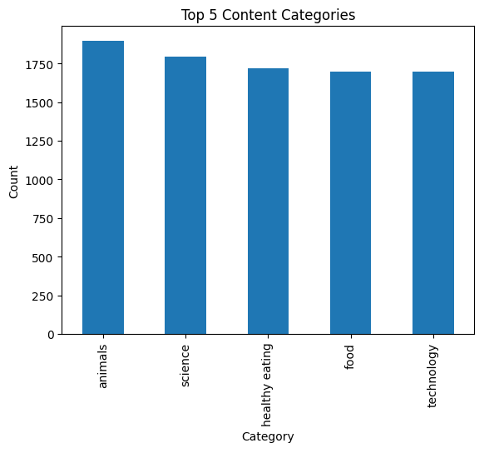

Insights
Top 5 Content Categories

Slide 7
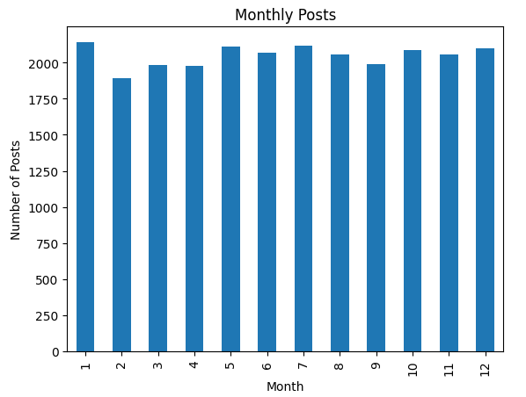
Monthly post containing month with highest reaction

Slide 8
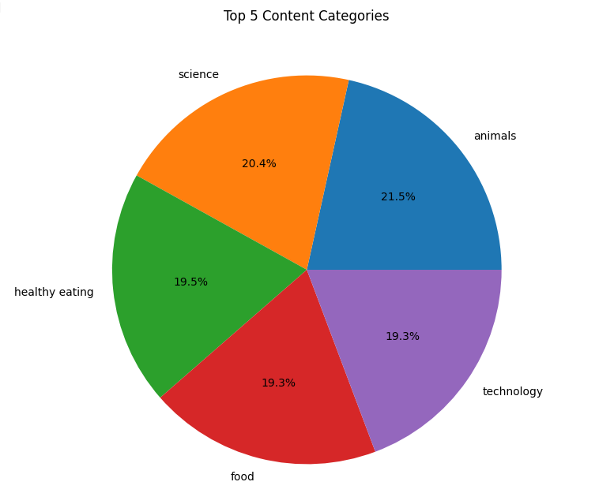
Pie chart of top 5 categories

Slide 9
Thank you!
ANY QUESTIONS?

